Slide 1
Problem Statement
Public services are essential for the well-being of citizens, yet accessing these services often poses significant challenges. The current fragmented and bureaucratic systems result in inefficiencies,delays and dissatisfaction among the general public.

Slide 2
Unique Idea Brief(Solution)
Concept: Centralized platform to integrate various public services (healthcare, education, utilities, etc.) into a single accessible interface.
Goal: Simplify access, improve service delivery, and enhance user experience by minimizing bureaucracy and reducing redundancies.
Benefits: Increased efficiency, cost savings, and improved satisfaction for citizens.

Slide 3
Features Offered
One-Stop Service Portal:
Unified login for multiple services
Personalized dashboard for users
Real-Time Updates:
Notifications on application status
Alerts for deadlines and renewals
Multi-Channel Access:
Web, mobile app, and in-person kiosks
Data Security and Privacy:
Robust encryption and compliance with data protection laws

Slide 4
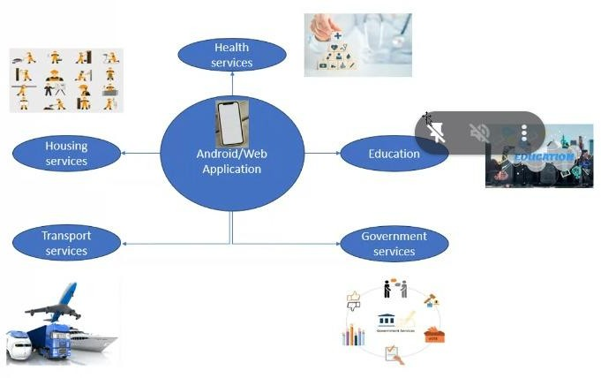

Slide 5
Process flow
User Registration:
Sign-up using personal identification
Verification through email or mobile number
Service Selection:
Browse available services
Select required service(s)
Application Submission:
Fill out necessary forms
Upload required documents
Processing:
Backend integration with respective departments
Automated workflow for approvals and updates

Slide 6
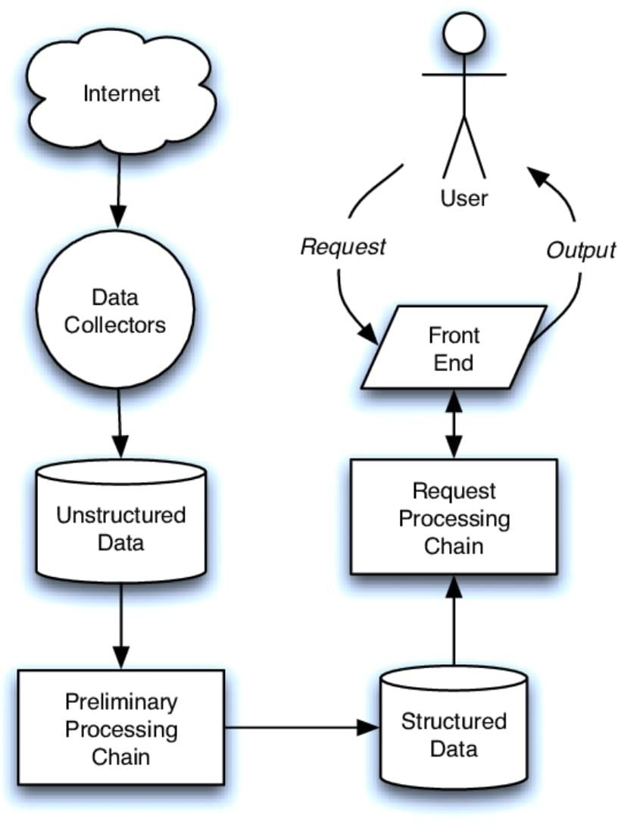
Architecture Diagram

Slide 7
Technologies used
Backend -
NodeJS and Express
Database –
MongoDb Atlas
Frontend –
ReactJS and Cors

Slide 8
Team members
Mukesh Raj .K – 230051601079 (Frontend and Backend Development)
Sarath Kumar.R – 230051601100 (Documentation)
Sherin.R – 230051601105 (Research and Resources)
Tehzeeb.T – 230051601120(Research and Resources)

Slide 9
Conclusion
Summary:
Integrated services provide a streamlined, user-friendly approach to public service delivery.
Impact:
Enhances efficiency, transparency, and satisfaction.
Call to Action:
Encourage stakeholders to support and adopt integrated service models for the betterment of society.

